Slide 1
Identifying Scholarly Articles for Historical Information
Russell Foo

Slide 2
Overview
Data Collection
Exploratory Data Analysis
Modelling
Insights

Slide 3


Data Collection
Notes:
The 2 threads I picked were History and No Such Thing as Stupid Questions.
Reasons:
The posts are in similar format (mostly question based) but the discussions themselves differ (historical vs regular)

Slide 4
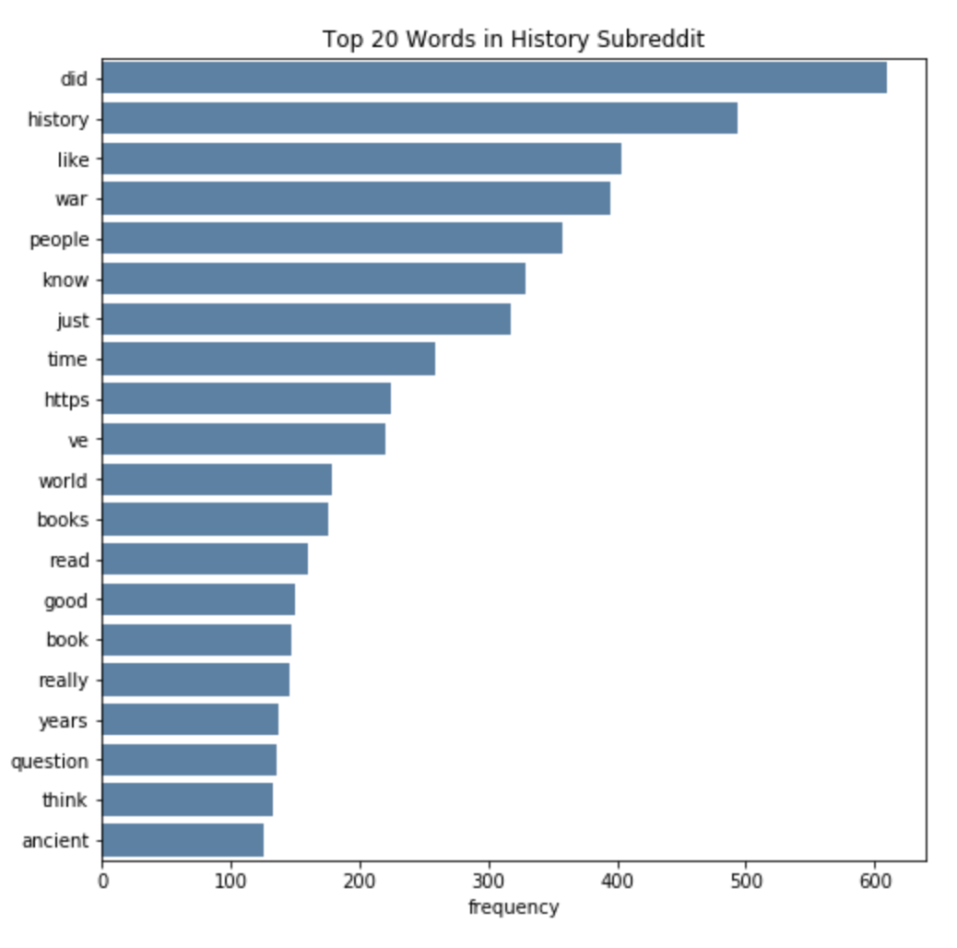
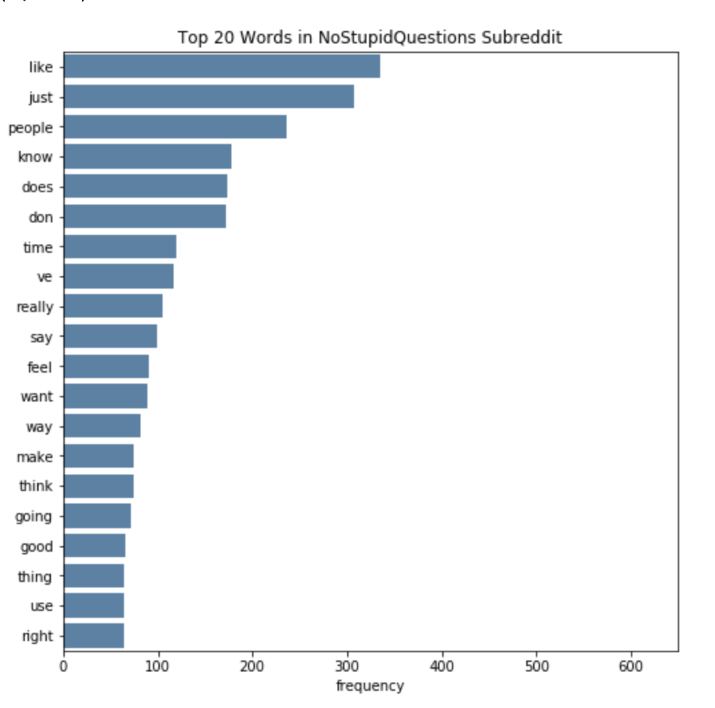
Exploratory Data Analysis

Slide 5
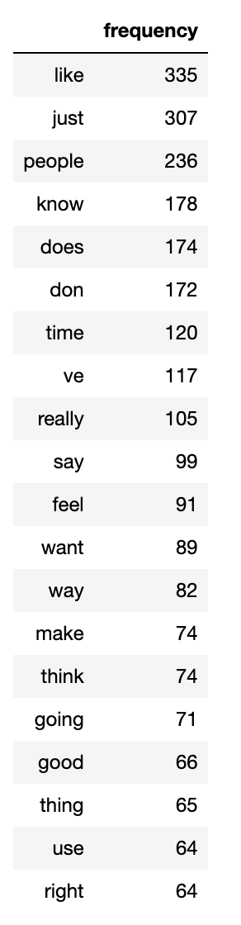
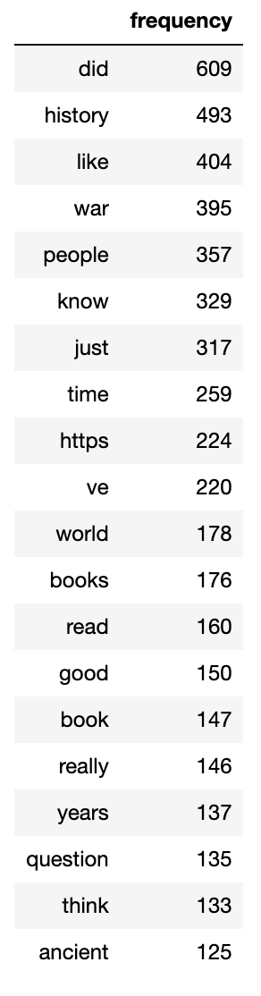
Exploratory Data Analysis

Slide 6
Exploratory Data Analysis

Slide 7
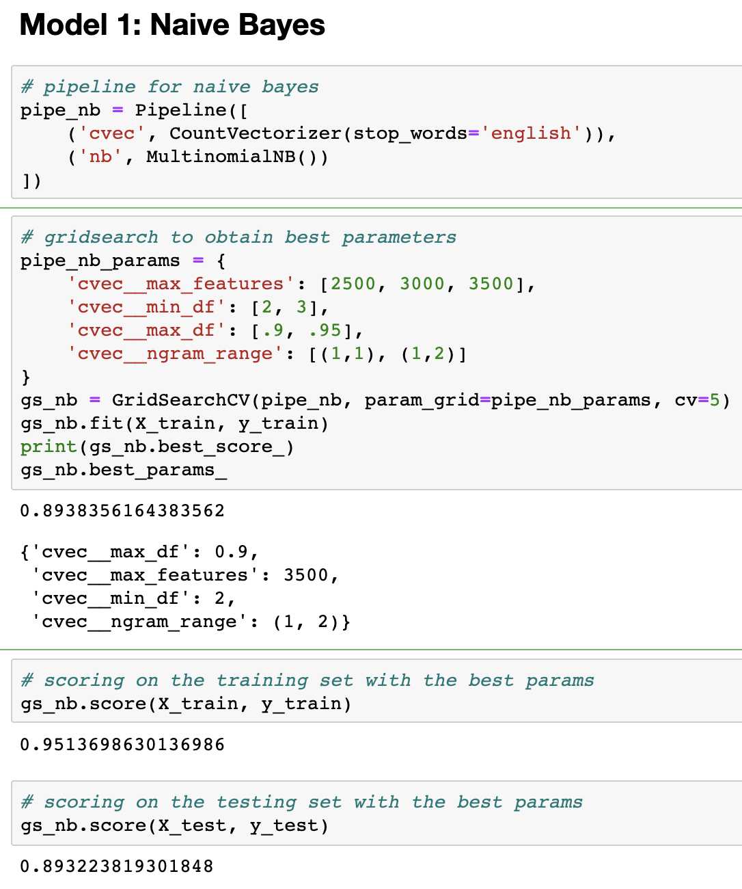
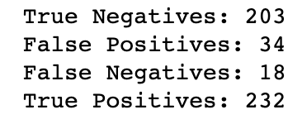
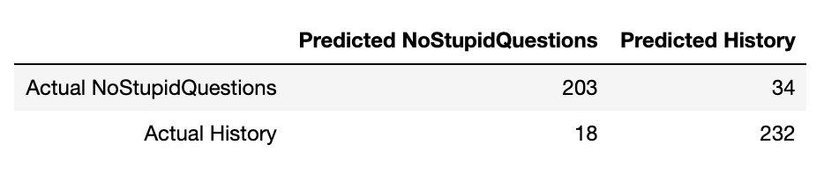
Modelling

Slide 8
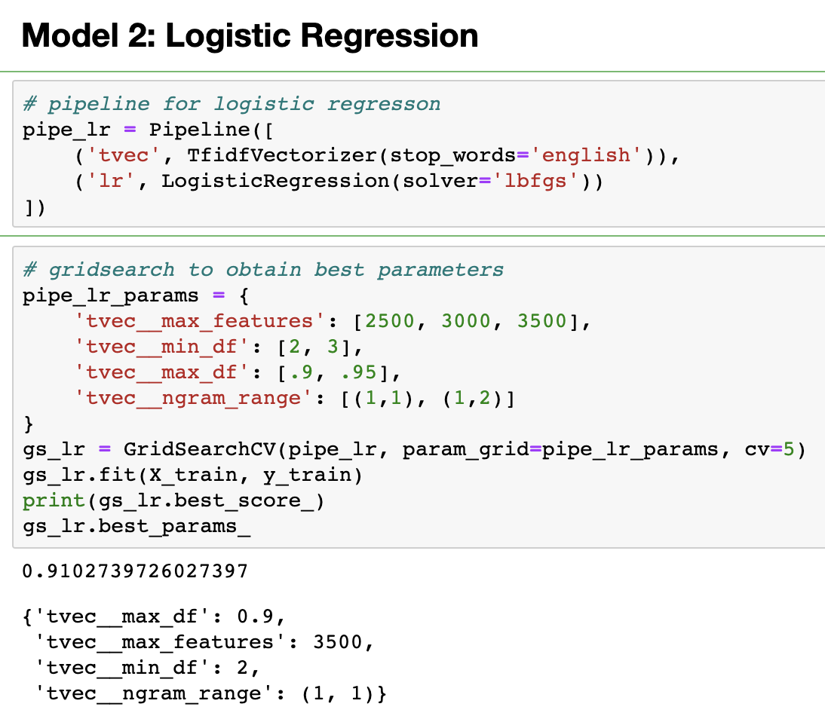
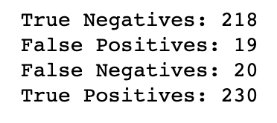
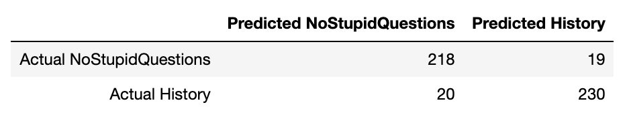
Modelling

Slide 9
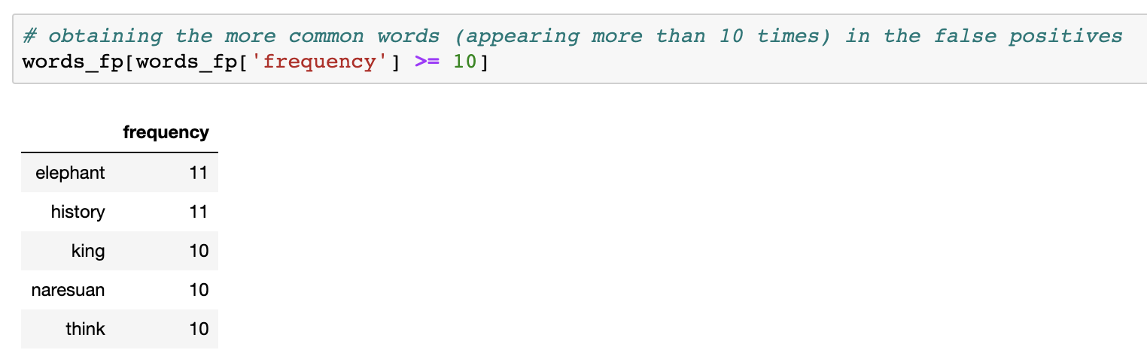
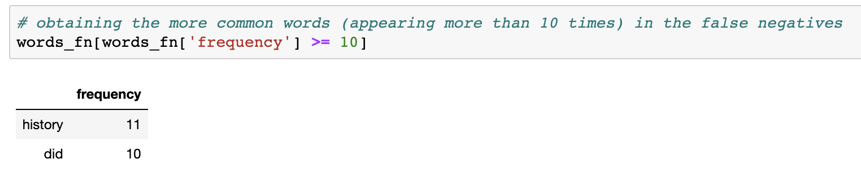
Misclassified

Slide 10
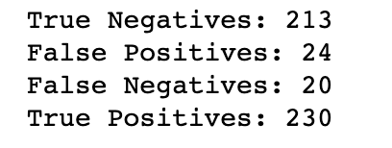
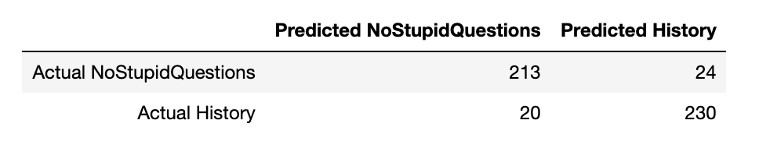
Misclassified

Slide 11
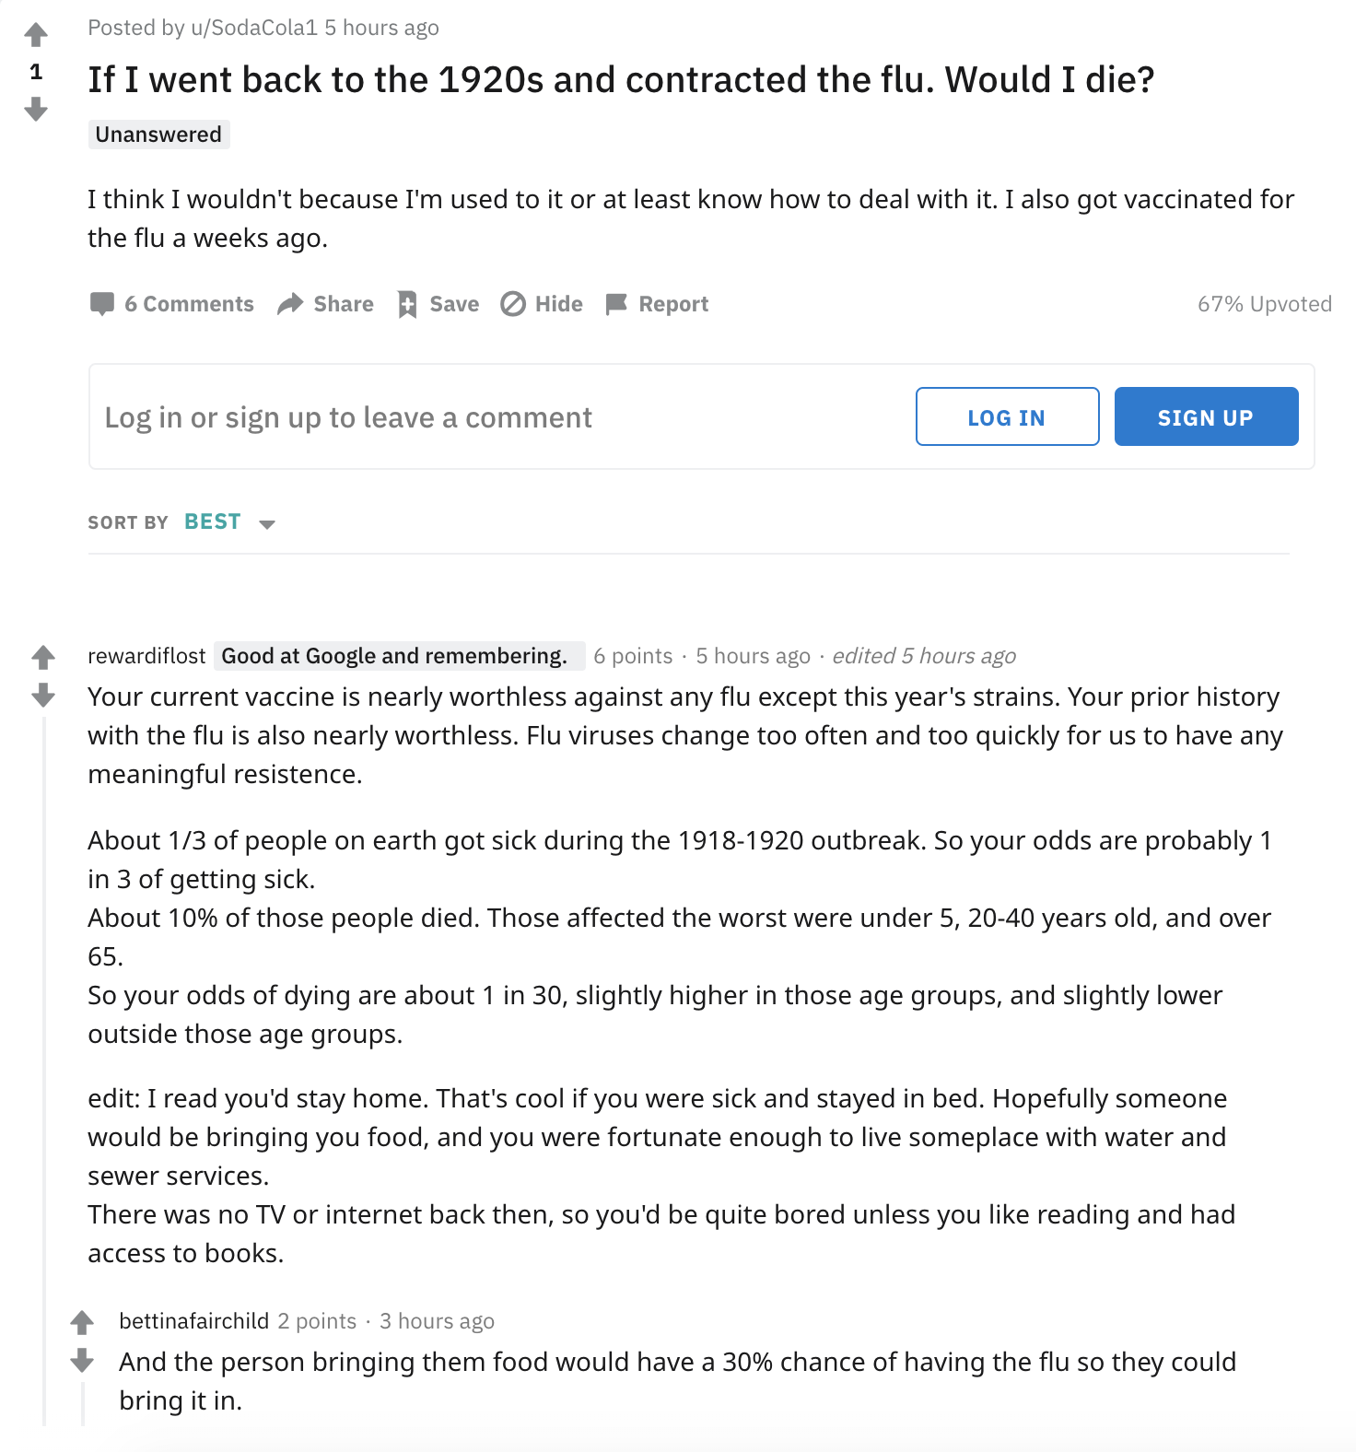
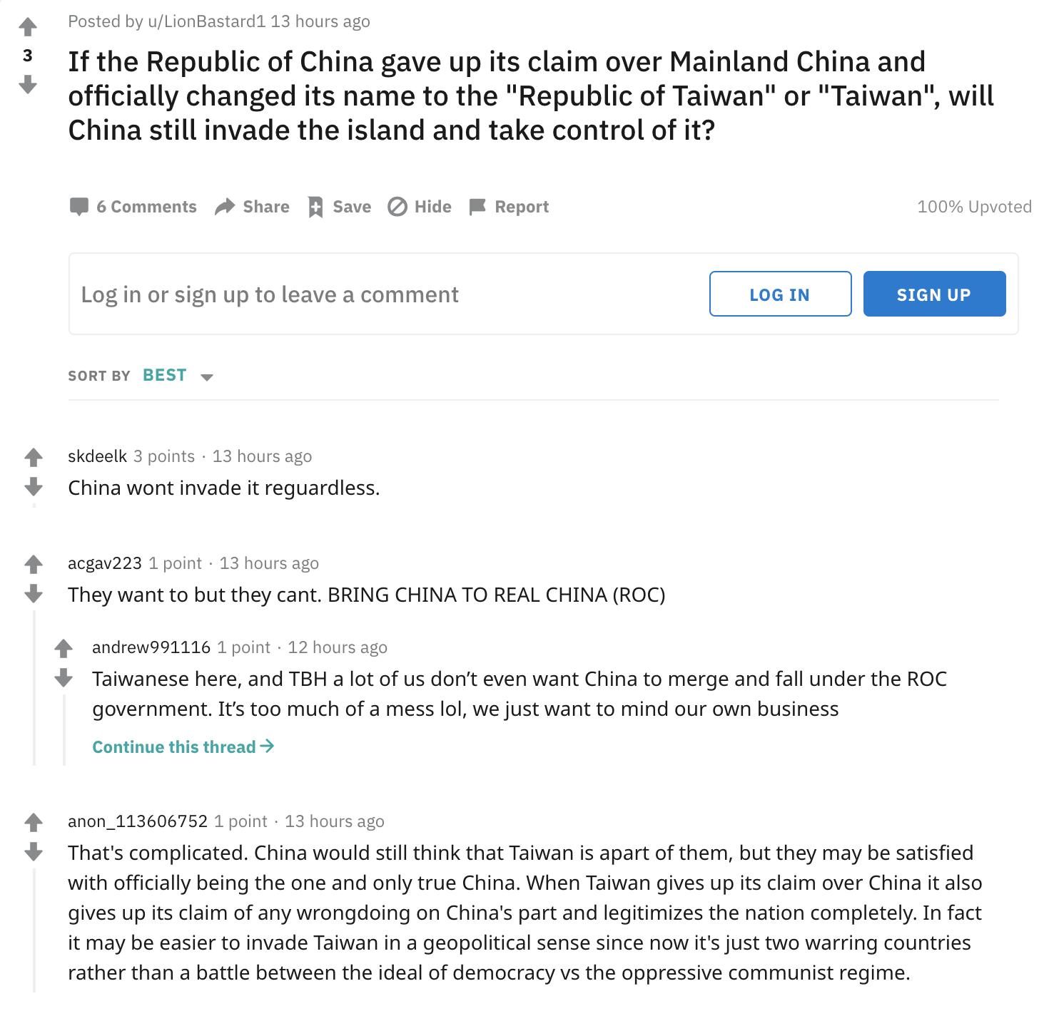
Insights and Conclusion

Slide 12
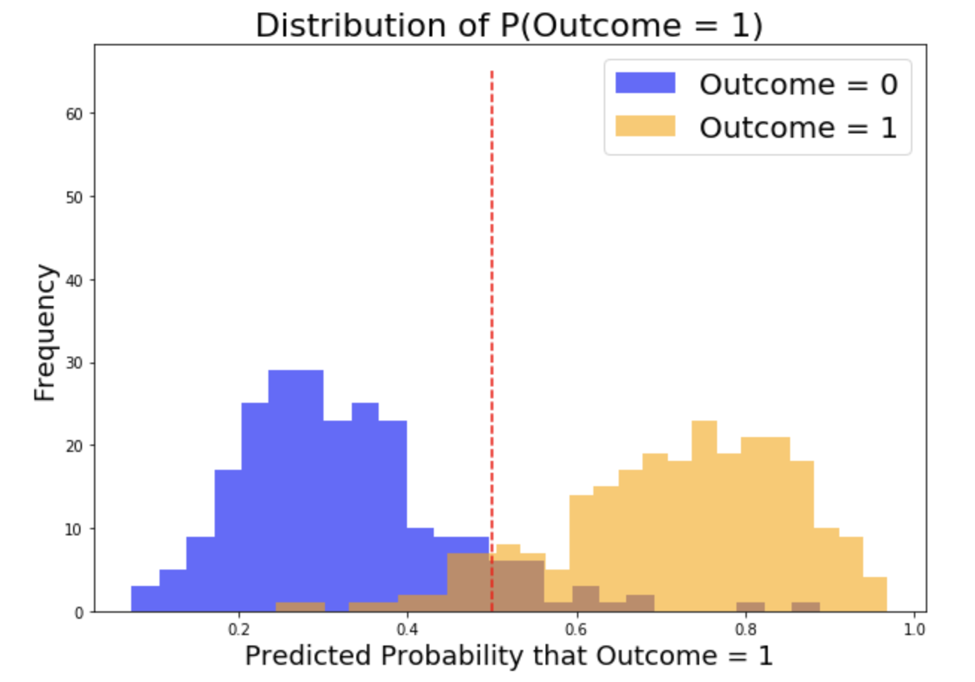
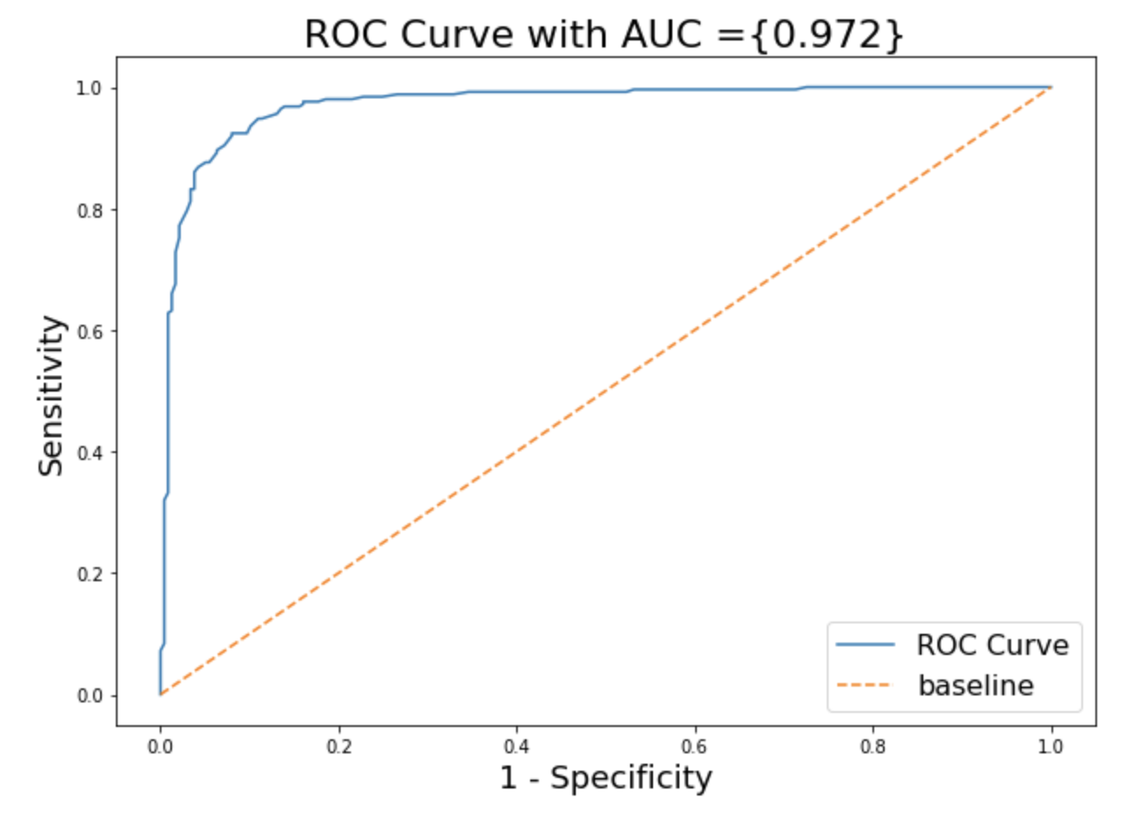
Insights and Conclusion

